Slide 1
Mapping Deprived Areas in Low- and Middle-Income Countries (LMIC) Capstone Project – Spring 2024 DATS 6501-12
Akhil Bharadwaj & Daqian Dang
April 30, 2024

Slide 2
Mapping project
Introduction
The prevalence and growth of slums in low- and middle- income countries (LMICs) present a significant challenge especially during COVID-19 pandemic and economic crisis.
Accurate mapping of deprived areas is important for monitoring Sustainable Development Goals (SDGs).
The IDEAMAPS Project
Aims to improve the consistency and accuracy of mapping deprived areas across cities, mainly focusing on African cities, specifically Lagos, Nigeria and Nairobi, Kenya.
Data sources and metrics
Open geospatial data sources: Google Maps Engine & OpenStreetMap
Relevant datasets: sentinel-2 imagery, covariate features, and contextual features
Model performance: F1 scores with balanced precision and recall values
The best-performing model will be determined by its ability to generalize and identify deprived areas across different urban settings

Slide 3
Challenges Identified in Literature
Lee and Kang (2015): Advanced algorithms needed for processing and storing diverse geospatial big data
Robinson et al. (2017): Difficulties in turning large data volumes into clear visual maps.
Lehner et al. (2020): Issues in deriving insights from unstructured data within urban environments.
Koldasbayeva et al. (2023): Tackle imbalanced datasets and spatial autocorrelation in environmental research.
Runfola et al. (2024): Applied deep learning to estimate socioeconomic factors from satellite imagery.
Application in Lagos and Nairobi
Accesses the impact of these factors on urban deprivation
Integrating Machine Learning and Deep Learning
Employs advanced analytical methods to process large datasets and identify complex urban patterns
Enhances the accuracy of urban deprivation classification

Slide 4
Raw Dataset Summary
Sentinel-2 Imagery -- A TIFF file with 10-meter resolution
Four features from the Sentinel-2 satellite image, representing different spectral bands (Red, Blue, Green, and Near-Infrared).
Covariate Features – A TIFF file with 100-meter resolution
53 band variables are designed to reveal unique patterns and trends across regions.
Contextual Features – 144 TIFF files with 10-meter resolution
144 individual features covers a variety of attributes, such as building counts, density, climate risk factors, housing quality, population density, and so on.

Slide 5
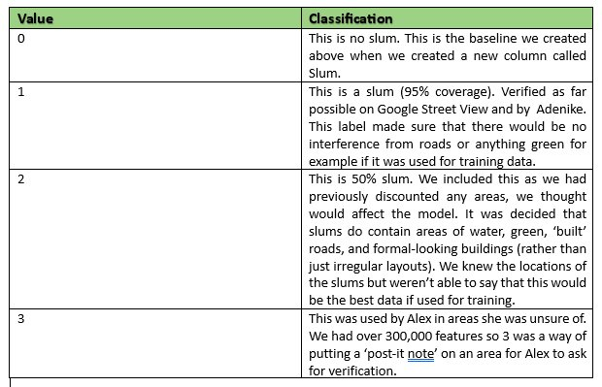
Reference Data
We combined slum labels 1 and 2 into a single value that indicates slum.
Slum label 3 was added to the test set as it was categorized as unsure which was used in modelling later for prediction.
Slum 0 was considered as non-deprived.

Slide 6
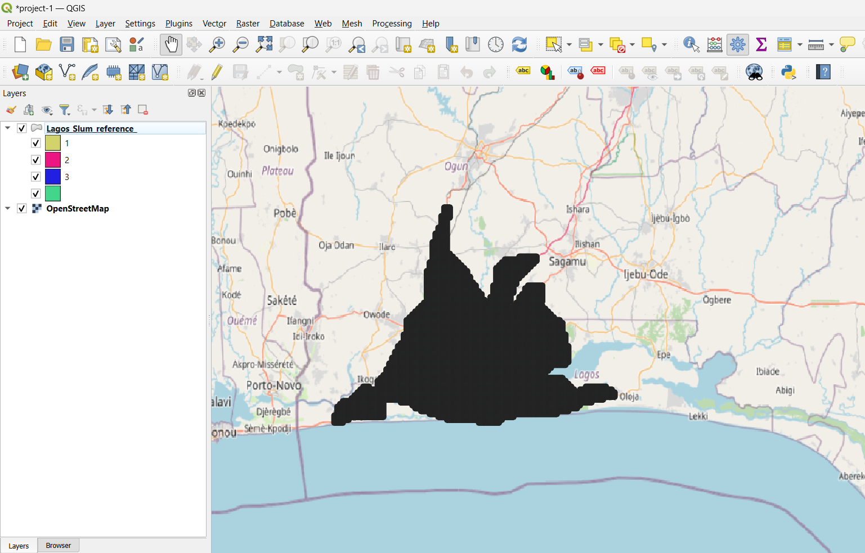
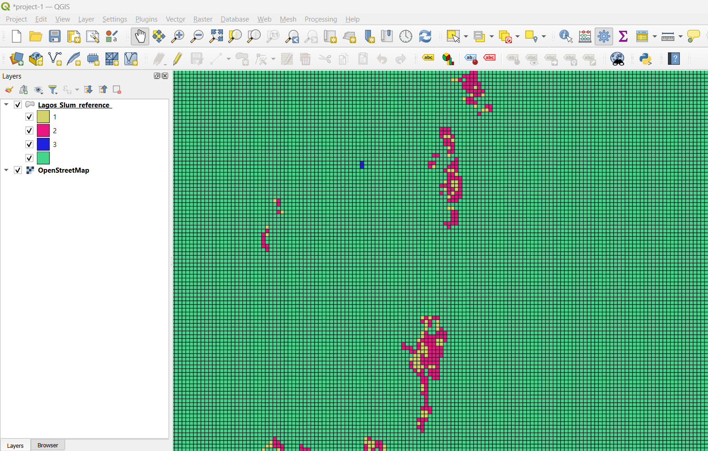
Working with QGIS

Slide 7
Data Pipeline Processing
Data pipeline – 100-meter resolution datasets
Data Pipeline workflow chart

Slide 8
Data Pipeline
1. Extracting Slum Labels and Covariate Band Values
Objective: Extract slum labels, geometric points, and 53 covariate band values from two inputs (Reference GPKG and Covariate TIFF).
Step: Execute the "extract_by_point.py" script.
Inputs: A reference GPKG file for Lagos and a covariate TIFF file.
Outputs: A CSV file named lagos_centroid.csv, containing slum labels, geometric points, and the 53 covariate band values.

Slide 9
2. Extracting Contextual Features
2.1 144 Individual Contextual TIFF Image Data Resampling
Objective: Automate the resampling of TIFF images to a specified scale using bilinear interpolation, converting resolutions from 10m to 100m.
Step: Run the "context_resampled_100m.py"script.
Inputs: 144 TIFF files with 10m resolutions under subdirectories
Output: 144 individual TIFF files with 100m resolutions
2.2 Initial Extraction
Objective: Retrieve geometric points and extract contextual feature information represented by 144 contextual values.
Step: Run the "extract_context_by_point.py" script.
Inputs: A100mGrid_Lagos GPKG file and 144 individual contextual feature TIFF files.
Output: A output directory named "contextual_features_extraction" that includes 144 individual CSV files, each containing contextual feature values and geometric points.
2.3 Merging Contextual Features
Objective: Combine the 144 individual CSV files into a single file.
Step: Execute the "merging_contextual_feature.py" script.
Inputs: The 144 individual CSV files.
Outputs: A single CSV file named merged_contextual_features.csv, consolidating all contextual data and geometric points.

Slide 10
3. Extracting Raw Image Data – Sentinel-2
3.1 Raster Data Resampling
Objective: Automate the resampling of a TIFF file to a specified scale using bilinear interpolation, converting resolutions from 10m to 100m.
Step: Run the "resampled_100m.py"script.
Inputs: A lag_bgrn TIFF file with 10m resolutions
Output: A resampling bgrn TIFF file with 100m resolutions
3.2 Extraction
Objective: Retrieve geometric points and corresponding four RBGN (Red, Blue, Green, Near-infrared) values from a TIFF image.
Step: Run the "extract_by_points_lag_bgrn.py" script.
Inputs: A100mGrid_Lagos GPKG file and a TIFF image "lag_bgrn.tif"
Outputs: A CSV file named lagos_bgrn.csv, containing geometric points and four RBGN values.

Slide 11
4. Data Combination
Objective: Merge the slum labels, contextual features, covariate band values, and RBGN values based on geometric points.
Step: Execute the "combined_data.py" script.
Inputs: lagos_centroid.csv, merged_contextual_features.csv, and lagos_bgrn.csv
Outputs: A comprehensive CSV file named final_output_lagos.csv, integrating all extracted data aligned by geometric points.

Slide 12
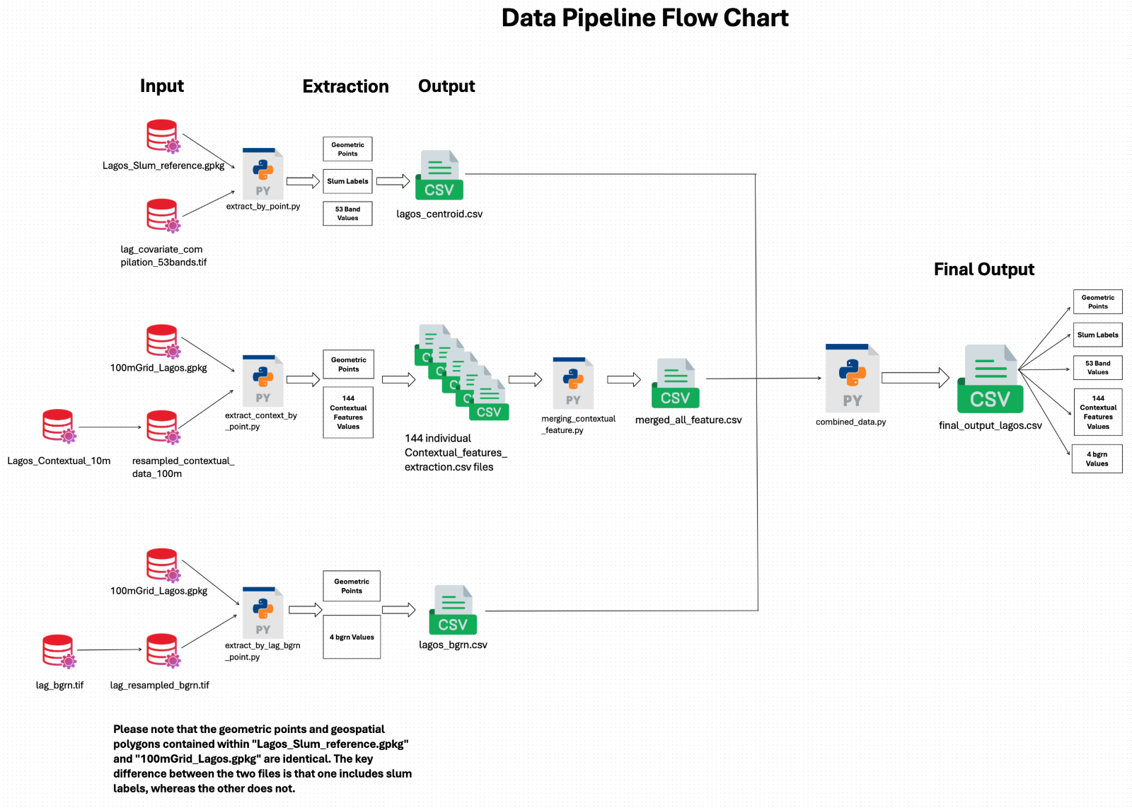

Slide 13
Dataset for modelling
Covariate feature: 53 band values
Contextual feature: 144 raster values from 144 individual contextual features
Pixel values: a Sentinel-2 image includes pixel values from 4 bands (Red, Blue, Green and Near-Infrared)
Total number of features: 53 (Covariate) + 144 (Contextual) + 4 (pixels) = 201
Target variable: Slum

Slide 14
Python packages used
Geopandas: An open-source project that makes working with geospatial data in python easier, acting as an extension of the pandas library to allow spatial operation on geometric types.
Geowombat: It provides utilities to process geospatial and raster data at scale. Easily process Landsat, Sentinel, or RGB data and others.
Rasterio: It simplifies reading and writing of raster datasets in python, allowing users to work with geospatial raster data more efficiently.
Pandas: A data manipulation and analysis library for python, offering data structures and operations for manipulating numerical tables.
Pycaret: An open-source, low-code machine learning library in Python that aims to reduce the cycle time from hypothesis to insights by providing workflow that automates machine learning tasks.

Slide 15
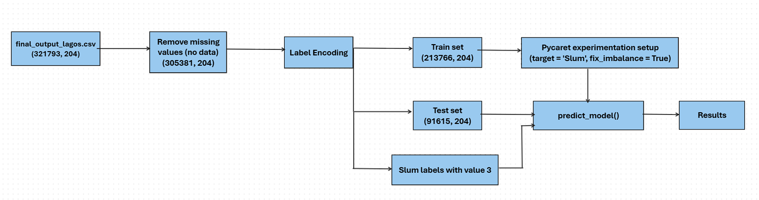
Modelling pipeline

Slide 16
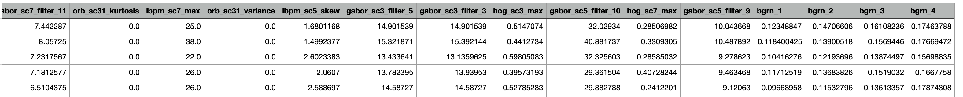
Snapshot of final_output_lagos.csv

Slide 17
Modelling results on test set (Lagos)
Model | Accuracy | AUC | Recall | Precision | F1 | Kappa | MCC
Logistic Regression | 0.9977 | 0.9337 | 0.085 | 0.3953 | 0.1399 | 0.1393 | 0.1825
Random Forest Classifier | 0.9987 | 0.9993 | 0.44 | 0.9263 | 0.5966 | 0.596 | 0.6379
K Neighbors Classifier | 0.9978 | 0.5034 | 0 | 0 | 0 | 0 | 0
XGBoost | 0.9989 | 0.9995 | 0.595 | 0.8322 | 0.6939 | 0.6933 | 0.7031
Multi-Layer Perceptron | 0.9978 | 0.5671 | 0 | 0 | 0 | 0 | 0
Decision Tree | 0.9981 | 0.7596 | 0.52 | 0.5683 | 0.5431 | 0.5421 | 0.5427
Ridge Classifier | 0.9978 | 0.5 | 0 | 0 | 0 | 0 | 0
Quadratic Discriminant Analysis | 0.9733 | 0.9849 | 0.995 | 0.0753 | 0.14 | 0.1365 | 0.27
Ada Boost Classifier | 0.9986 | 0.9962 | 0.53 | 0.7413 | 0.6181 | 0.6174 | 0.6261
Gradient Boosting Classifier | 0.9981 | 0.8009 | 0.265 | 0.6625 | 0.3786 | 0.3778 | 0.4183
Extra Trees Classifier | 0.9986 | 0.9993 | 0.405 | 0.9205 | 0.5625 | 0.5619 | 0.6101
Light Gradient Boosting Machine | 0.9938 | 0.8028 | 0.435 | 0.1608 | 0.2348 | 0.2324 | 0.262
Dummy Classifier | 0.9978 | 0.5 | 0 | 0 | 0 | 0 | 0
Support Vector Machine | 0.9965 | 0.5043 | 0.01 | 0.0161 | 0.0123 | 0.0107 | 0.011
Naive Bayes | 0.0687 | 0.9138 | 0.995 | 0.0023 | 0.0046 | 0.0003 | 0.0116

Slide 18
Modelling results on test set (Lagos) after balancing
Model | Accuracy | AUC | Recall | Precision | F1 | Kappa | MCC
Logistic Regression | 0.918 | 0.9566 | 0.885 | 0.0231 | 0.045 | 0.0409 | 0.1353
Random Forest Classifier | 0.9982 | 0.9988 | 0.605 | 0.5789 | 0.5917 | 0.5908 | 0.5909
K Neighbors Classifier | 0.9392 | 0.5583 | 0.17 | 0.0062 | 0.0121 | 0.0079 | 0.0219
XGBoost | 0.999 | 0.9994 | 0.73 | 0.7807 | 0.7545 | 0.754 | 0.7544
Multi-Layer Perceptron | 0.9774 | 0.9742 | 0.855 | 0.0773 | 0.1417 | 0.1383 | 0.2531
Decision Tree | 0.9971 | 0.769 | 0.54 | 0.383 | 0.4481 | 0.4467 | 0.4534
Ridge Classifier | 0.9661 | 0.973 | 0.98 | 0.0594 | 0.112 | 0.1083 | 0.237
Quadratic Discriminant Analysis | 0.9832 | 0.9871 | 0.98 | 0.1134 | 0.2033 | 0.2002 | 0.3305
Ada Boost Classifier | 0.9936 | 0.9956 | 0.81 | 0.2278 | 0.3557 | 0.3534 | 0.4276
Gradient Boosting Classifier | 0.9938 | 0.9985 | 0.94 | 0.2517 | 0.397 | 0.395 | 0.4847
Extra Trees Classifier | 0.9987 | 0.9992 | 0.75 | 0.6977 | 0.7229 | 0.7223 | 0.7227
Light Gradient Boosting Machine | 0.9987 | 0.9992 | 0.745 | 0.6835 | 0.7129 | 0.7123 | 0.7129
Dummy Classifier | 0.9978 | 0.5 | 0 | 0 | 0 | 0 | 0
Support Vector Machine | 0.8674 | 0.8263 | 0.785 | 0.0128 | 0.0252 | 0.021 | 0.0895
Naive Bayes | 0.0713 | 0.6147 | 0.995 | 0.0023 | 0.0047 | 0.0003 | 0.0118

Slide 19
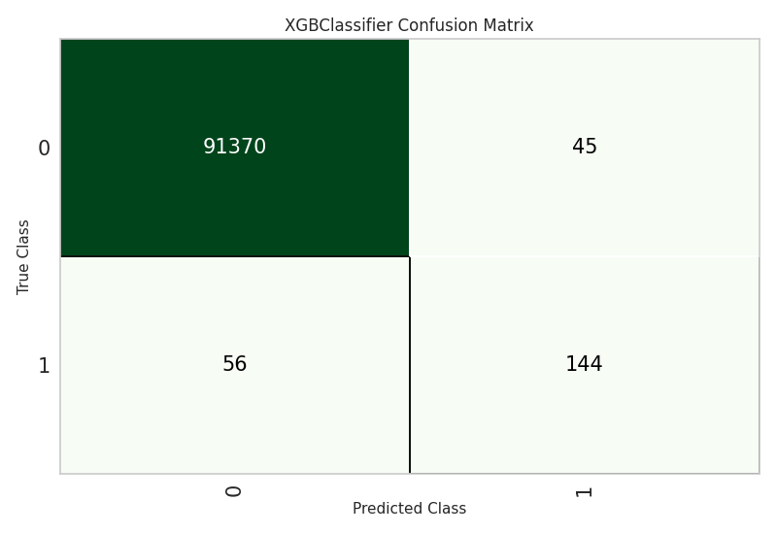
Confusion matrix for XGBoost

Slide 20
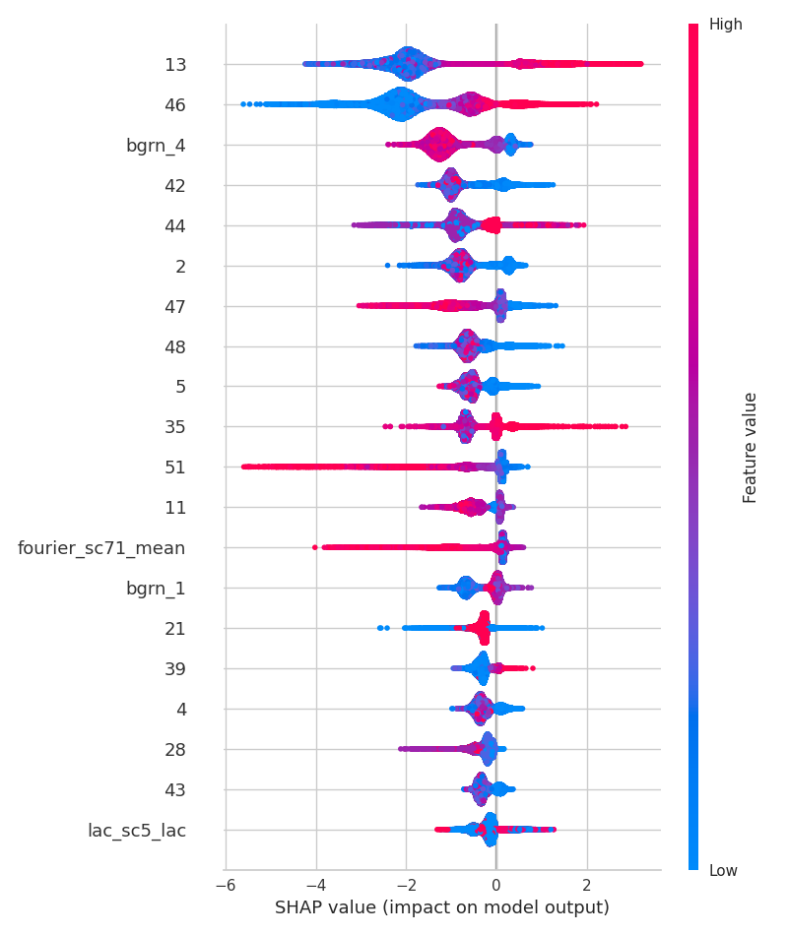
Impact of features on model output
Covariate Feature | Description
13 | ph_dist_cultivated_2015
46 | uu_bld_den_2020
42 | sh_dist_mnr_pofw_2019
44 | sh_ethno_den_2020
2 | fs_dist_school_2020
47 | uu_impr_housing_2015
48 | fs_dist_hf_2019
5 | in_dist_waterway_2016
35 | ses_m_lit_2018
51 | ph_dist_riv_network_2007
11 | ph_dist_art_surface_2015
21 | ph_grd_water_2000
39 | ses_preg_2017
4 | in_dist_rd_intersect_2016
28 | ph_slope_2000
43 | sh_dist_pofw_2019

Slide 21
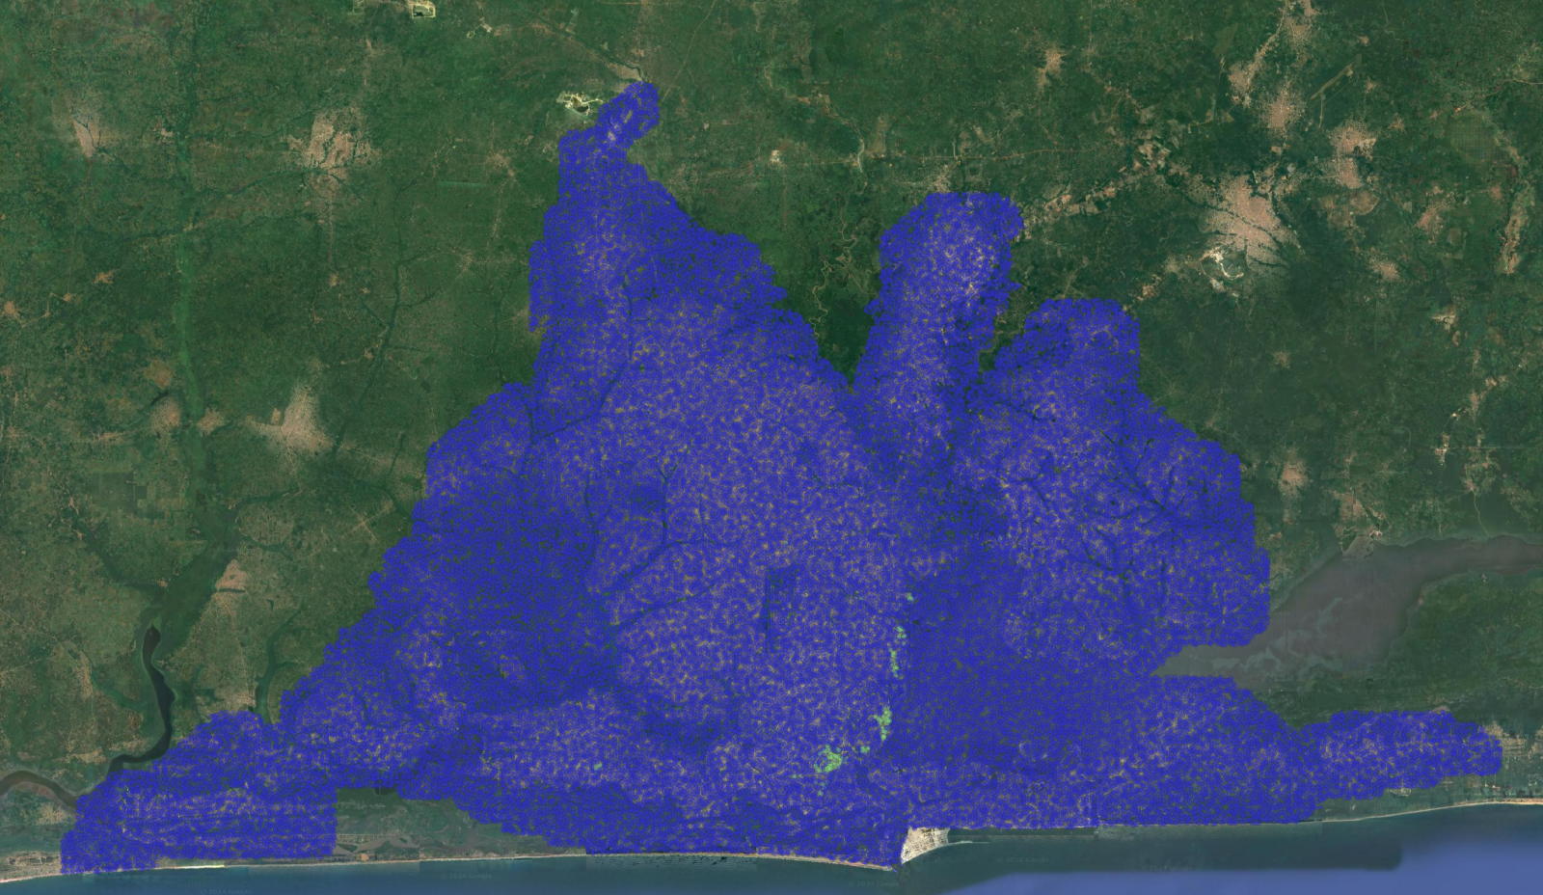
Mapping slum labels on QGIS for Lagos

Slide 22
Further steps
Run the models trained for one area and test it on another area (Nairobi).
Train deep learning models like CNN using the sentinel-2 images and labels.
Run the models using the 10m resolution.

Slide 23
Reference
Lee, J.-G., & Kang, M. (2015). Geospatial Big Data: Challenges and Opportunities. Big Data Research, 2(2), 74–81. https://doi.org/10.1016/j.bdr.2015.01.003
Robinson, A. C., Demšar, U., Moore, A. B., Buckley, A., Jiang, B., Field, K., Kraak, M.-J., Camboim, S. P., & Sluter, C. R. (2017). Geospatial big data and cartography: research challenges and opportunities for making maps that matter. International Journal of Cartography, 3(sup1), 32–60. https://doi.org/10.1080/23729333.2016.1278151
Kovacs-Györi, A., Ristea, A., Havas, C., Mehaffy, M., Hochmair, H. H., Resch, B., Juhasz, L., Lehner, A., Ramasubramanian, L., & Blaschke, T. (2020). Opportunities and Challenges of Geospatial Analysis for Promoting Urban Livability in the Era of Big Data and Machine Learning. ISPRS International Journal of Geo-Information, 9(752).
Koldasbayeva, D., Tregubova, P., Gasanov, M., Zaytsev, A., Petrovskaia, A., & Burnaev, E. (2023). Challenges in data-based geospatial modeling for environmental research and practice. arXiv.Org. https://doi.org/10.48550/arxiv.2311.11057
Runfola, D., Stefanidis, A., Lv, Z., O’Brien, J., & Baier, H. (2024). A multi-glimpse deep learning architecture to estimate socioeconomic census metrics in the context of extreme scope variance. International Journal of Geographical Information Science, 1–25. https://doi.org/10.1080/13658816.2024.2305636
Engstrom, R., Owusu, M., Nair, A., Jafari, A., Thomson, D., & Kuffer, M. (2023). Evaluating the ability to use contextual features to map deprived areas ‘slums’ in multiple cities. IGARSS 2023 - 2023 IEEE International Geoscience and Remote Sensing Symposium. https://doi.org/10.1109/igarss52108.2023.10282954
Owusu, M., Engstrom, R., Thomson, D., Kuffer, M., & Mann, M. L. (2023, November 8). Mapping deprived urban areas using open geospatial data and machine learning in Africa. MDPI. https://www.mdpi.com/2413-8851/7/4/116/htm
Owusu, M., Kuffer, M., Belgiu, M., Grippa, T., Lennert, M., Georganos, S., & Vanhuysse, S. (2021). Towards user-driven earth observation-based slum mapping. Computers, Environment and Urban Systems, 89, 101681. https://doi.org/10.1016/j.compenvurbsys.2021.101681
T. Stark, M. Wurm, H. Taubenböck and X. X. Zhu, "Slum Mapping in Imbalanced Remote Sensing Datasets Using Transfer Learned Deep Features," 2019 Joint Urban Remote Sensing Event (JURSE), Vannes, France, 2019, pp. 1-4, doi: 10.1109/JURSE.2019.8808965.
Fisher, T., Gibson, H. W., Liu, Y., Abdar, M., Posa, M., Salimi‐Khorshidi, G., Hassaïne, A., Cai, Y., Rahimi, K., & Mamouei, M. (2022). Uncertainty-Aware interpretable deep learning for slum mapping and monitoring. Remote Sensing, 14(13), 3072. https://doi.org/10.3390/rs14133072

